Slide 1
AIRLINE DRIVE DRAINAGE AND PAVING- SUBPROJECT 2-CLARK ROAD CONSTRUCTION COMMUNITY MEETING Project No. M-000284-0002-4
Jeff Chukwu| Construction Manager | September 11, 2018

Slide 2
AGENDA
Overview of the Project
Project Phasing
What to Expect During Construction
Contact Information

Slide 3
OVERVIEW
Purpose: To provide storm drainage improvements to residents
Construction Cost: $13.2 Million
Timeline: 09/17/2018 Construction begins
08/05/2020 Anticipated project completion
2018
2020
Fall
Construction Begins
Summer
Anticipated Completion

Slide 4
OVERVIEW
Project Scope
Replace the old storm sewer system with new system to provide:
Improved Storm drainage
Increased storage capacity
Pedestrian safety and accessibility

Slide 5
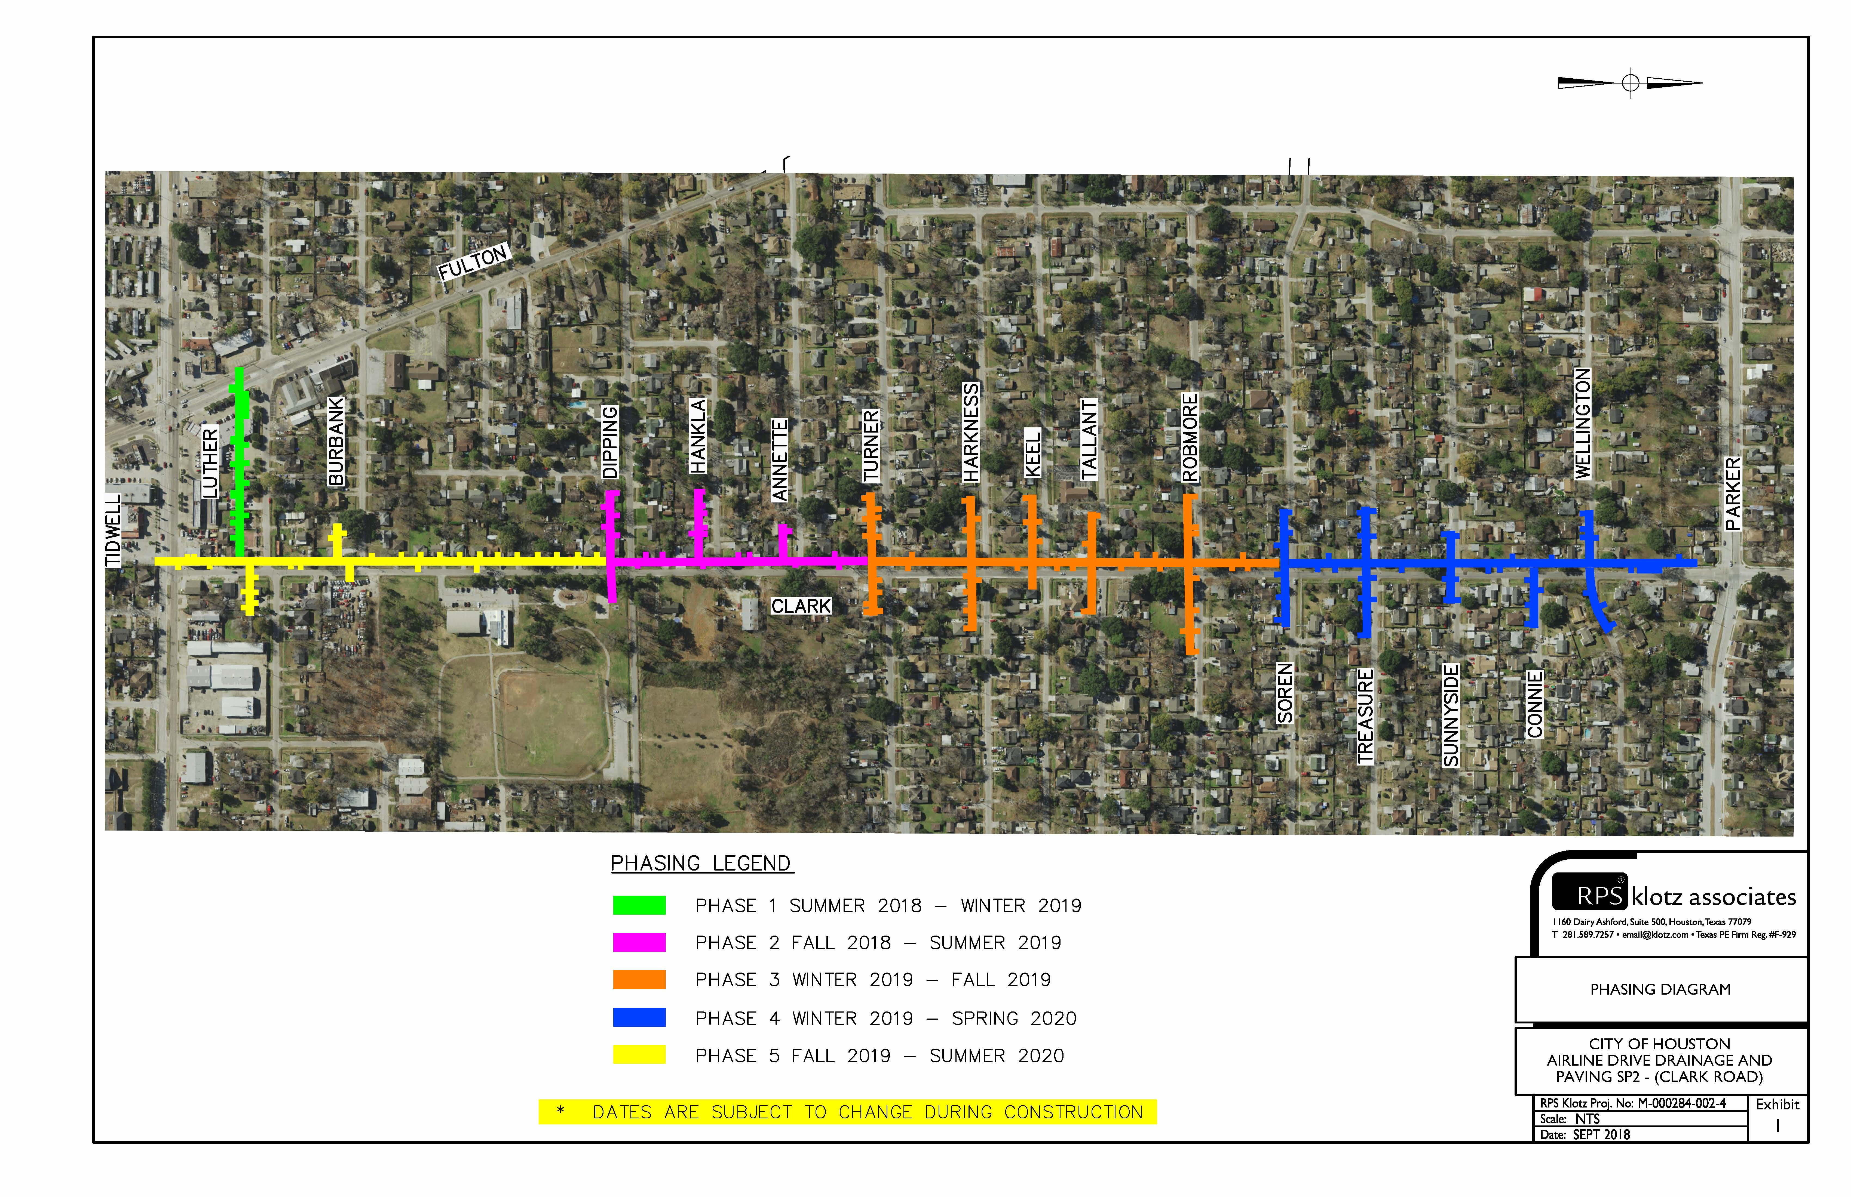
PROJECT PHASING
* SUBJECT TO CHANGES AS PROJECT UPDATES OCCUR.

Slide 6
WHAT TO EXPECT DURING CONSTRUCTION
Prepare for Construction
Construction is within City Right-of-way
Know how to report a concern or problem
Be aware of the potential service impacts
Restoration

Slide 7
WHAT TO EXPECT DURING CONSTRUCTION
City Right-of-Way (ROW)
City ROW generally extends 2 feet from the edge of the sidewalk
Remove items of value (special landscaping features such as fountains, decorative/brick mailboxes and lawn art) within the City ROW
Document the conditions of your yard and sprinkler head locations. Contractor will do the same.
Expect temporary lane closures during the process.

Slide 8
WHAT TO EXPECT DURING CONSTRUCTION
How to Report a Concern or Problem
Keep your door hanger throughout the project
Lists phone numbers you need
Lists the Project Number
Contact 311
Report the project name and the project number
Request issue be directed to Houston Public Works- Capital Projects
Be as complete as possible with your concern
Meet the Construction Manager or Inspector
Will be your contact to resolve issues throughout construction

Slide 9
WHAT TO EXPECT DURING CONSTRUCTION
Potential Water Service Impacts
Planned service interruption:
Waterline replacement - notification 24 to 48 hours in advance
Periodic
Typically last 2 to 4 hours
Accidental/Unplanned Interruption:
The contractor will work quickly to restore services.

Slide 10
WHAT TO EXPECT DURING CONSTRUCTION
Parking and Driveway Access
Periods of limited access to your driveway
Park somewhere and walk to your home
Contact us immediately if needing handicapped access
Short periods of no on-street parking
Construction will alternate each side of the street on different schedules
Suggest working with neighbors on the opposite side- they may need your help when it’s their turn

Slide 11
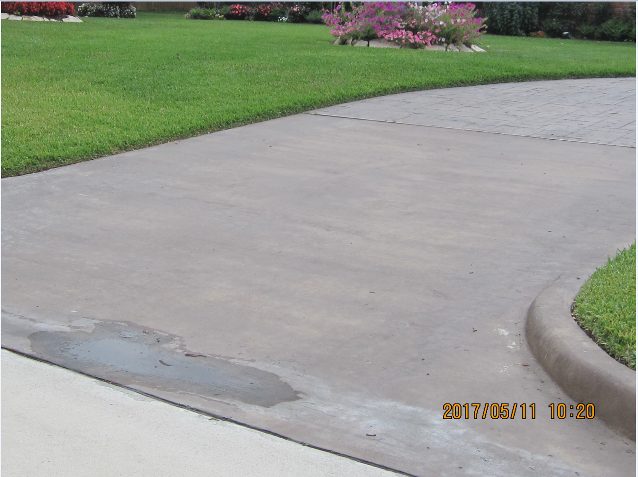
WHAT TO EXPECT DURING CONSTRUCTION
Custom Driveway Options
Option 1: Remove and replace existing driveway with plain reinforced concrete at no cost to the home owner.
Option 2-Custom: Grade the subgrade to proper slope and form the driveway to meet the new grades /slope. You would see the finished dirt with proper slope. Home Owner to finish the Driveway with their desired finish at their cost.
(Driveway must be finished 2 weeks after it’s been prepped by the City.)
Driveway Construction Coordination

Slide 12
WHAT TO EXPECT DURING CONSTRUCTION
Trash/Recycling Pick-up
Construction will alternate each side of the street on different schedules
Waste receptacles should be placed on the non-affected side of the street

Slide 13
WHAT TO EXPECT DURING CONSTRUCTION
Potential Bus Re-Routes
School Buses
The City of Houston and the Contractor will work with all schools to minimize impacts to students, school bus schedules, and school bus stops
School buses may need to use different streets temporarily
Metro Buses
No metro bus stops will be affected or re-routed due to construction

Slide 14
WHAT TO EXPECT DURING CONSTRUCTION
Tree Impact
Our goal is to protect all trees during construction.
We accomplish this by working with the City Arborist.
Currently as part of this project only diseased trees are set to be removed

Slide 15
WHAT TO EXPECT DURING CONSTRUCTION
Restoration
Restoration of sprinkler systems, grass, etc. will be done during the final stage of construction.
City does not approve final payment to contractor until restoration is complete.
If you have concerns:
Document (writing, photo, etc.)
Call 3-1-1
Do not make the repairs yourself

Slide 16
CONTACT INFORMATION
SER Construction Partners, LLC.(contractor)
Ben Cross, Project Manager | (832) 334-6899
Otilio Garcia, Superintendent | (713) 476-8193
City of Houston Staff (oversight)
Jeff Chukwu, Construction Manager (CM&I Team) | (832) 677-0596
Sabastian Ezenwa, Inspector (CM&I Team) | (281) 818-8566
Nupur Krishnan, Project Manager (COH) | (832) 395-2351

Slide 17
IMPORTANT LINKS
For a complete listing of Frequently Asked Questions please visit:
https://www.publicworks.houstontx.gov/ecd/faqs.html
Today’s presentation and additional project information can be found at:
https://rebuildhouston.org/community-engagement

Slide 18
THANK YOU
Next Up
Question & Answer
Breakout session

