Slide 1
Binglewood Area Drainage and Paving Improvements
(WBS No. M-000293-0001-4)
Preconstruction Community Meeting
Kevin Hammond, P.E.
(City of Houston – Capital Projects)
December 9, 2017

Slide 2
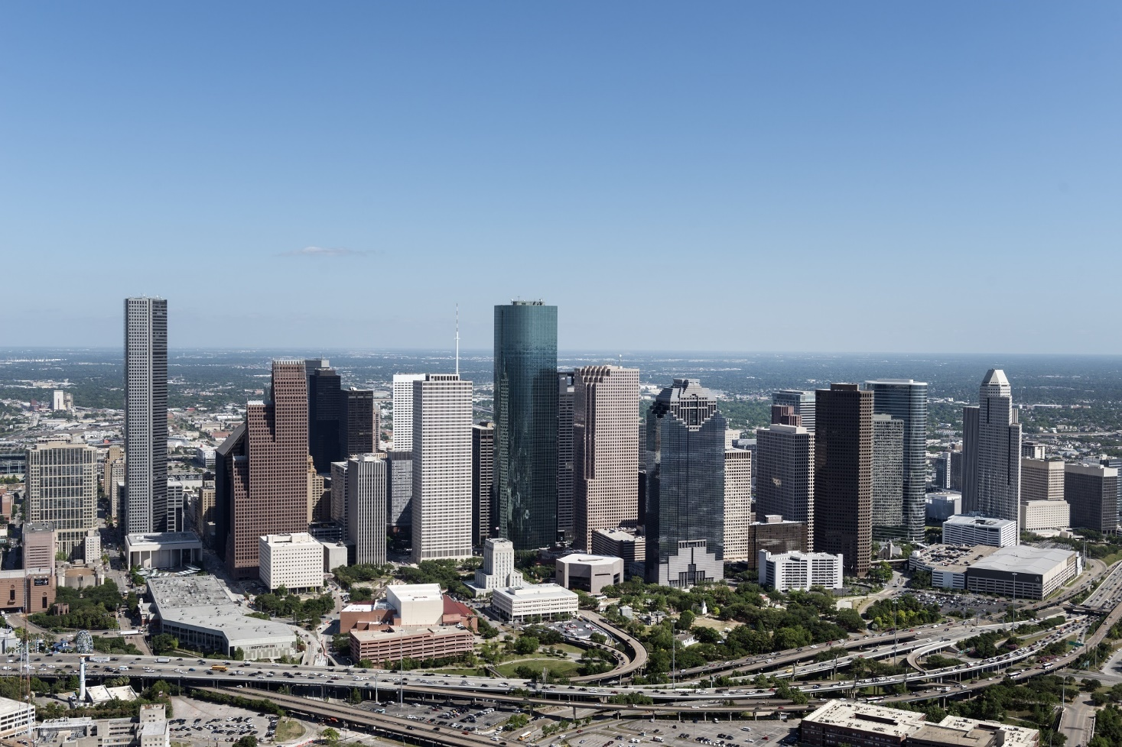
AGENDA
1 | OVERVIEW OF THE PROJECT
2 | PROJECT SCOPE AND PHASING
3 | WHAT TO EXPECT DURING CONSTRUCTION
4 | CONTACT INFORMATION

Slide 3
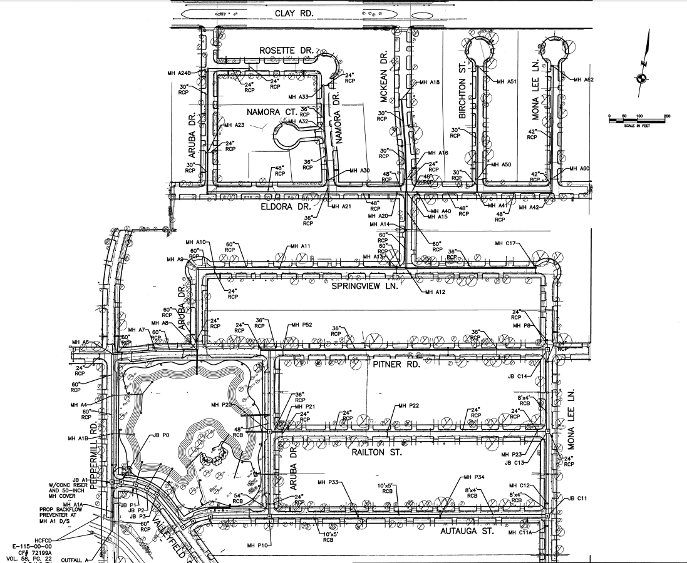
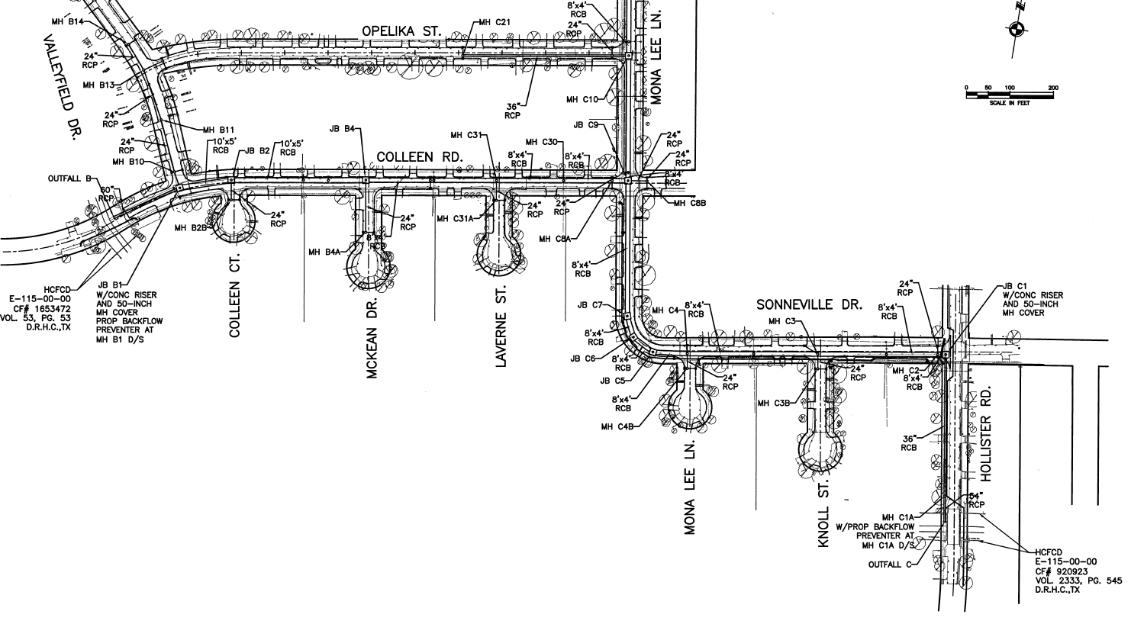

Binglewood Area Drainage and Paving
(WBS No. M-000293-0001-4)
2017/2018
2019
Winter
Construction Begins
Fall
Anticipated Completion
Notes:
Good Evening. It’s good to be back out here along Greenbriar Street. I’m excited to share with you where the City is on the Greenbriar Reconstruction Project. Hopefully most of you have had a chance to look at the various exhibits around the room. The layout of the full project is on that wall over there (gestures to wall). So, let’s get oriented and I can begin to walk you through the recommended plan.
Starting on the left, we are at the intersection of Greenbriar with West Holcombe. Traveling to the right, you would be driving north- passing Roberts Elementary on the right, through the intersection at University Boulevard, Rice Stadium and arriving at the northern end of the project at Rice Boulevard.

Slide 4
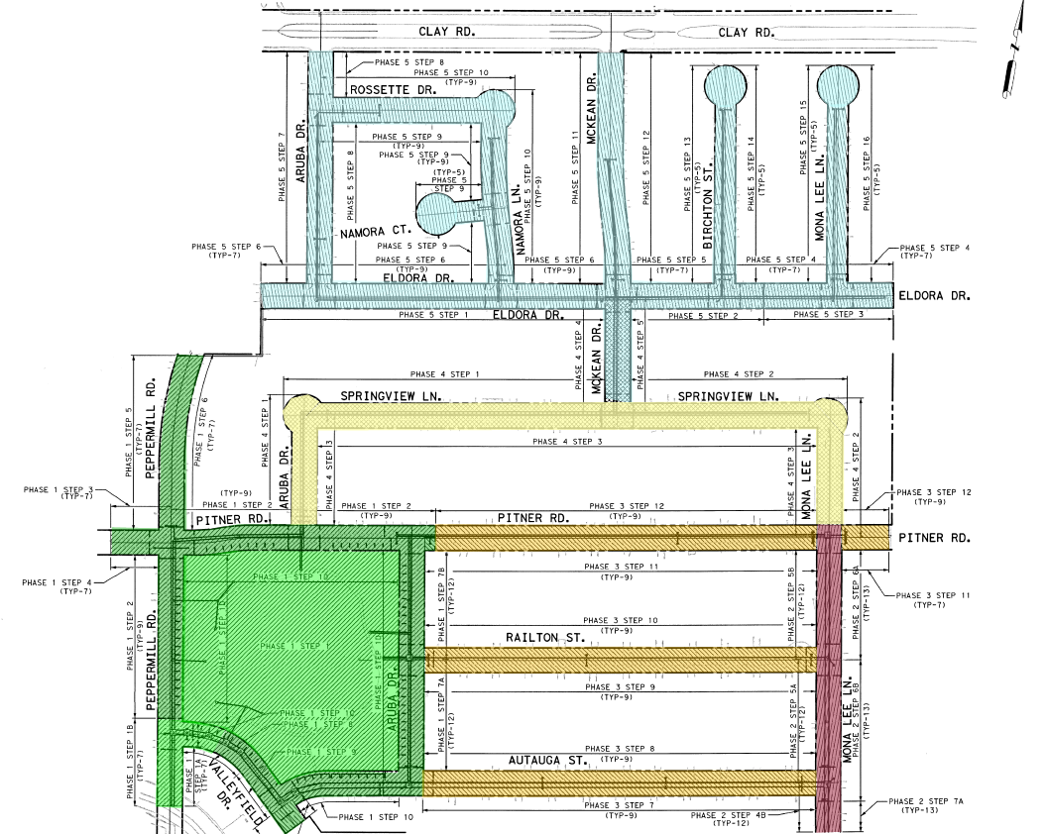

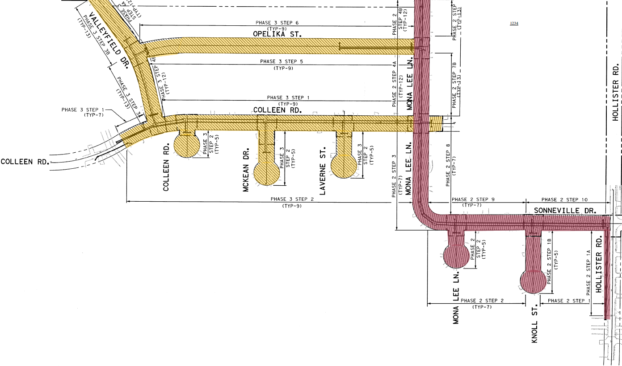
Binglewood Area Drainage and Paving
(WBS No. M-000293-0001-4)
Construction Phasing Exhibit
PHASE 1 - Winter 2018 to Summer 2018
PHASE 2 - Summer 2018 to Winter 2019
PHASE 3 - Winter 2019 to Spring 2019
PHASE 4 - Spring 2019 to Summer 2019
PHASE 5 - Summer 2019 to Fall 2019
NOTE:
EXPECTED DATES ARE PRELIMINARY ESTIMATES, MAY CHANGE DURING CONSTRUCTION.

Slide 5




Binglewood Area Drainage and Paving
(WBS No. M-000293-0001-4)
Identified Improvement Needs
Storm drainage
Roadway section
Water
  Park Improvements, shared space for Stormwater Detention
Notes:
The project will include:
Reconstructed roadway with curbs and gutters
Reconstructed sidewalks, driveways and curb ramps
Reconstructed storm sewer, sanitary sewer, and waterlines
Improve mobility
The roadway improvements will enhance the area as well as the ride.
Reconstruct existing sidewalks and add new sidewalks
Sidewalks will be 5 feet wide (4 foot sidewalks will be constructed if possible in an effort to preserve trees)
Reconstruct drainage system, sanitary sewer and waterlines
Upsized storm sewer system
Updates to sanitary sewer mains and services in certain areas
Updates to water mains and services in certain areas

Slide 6
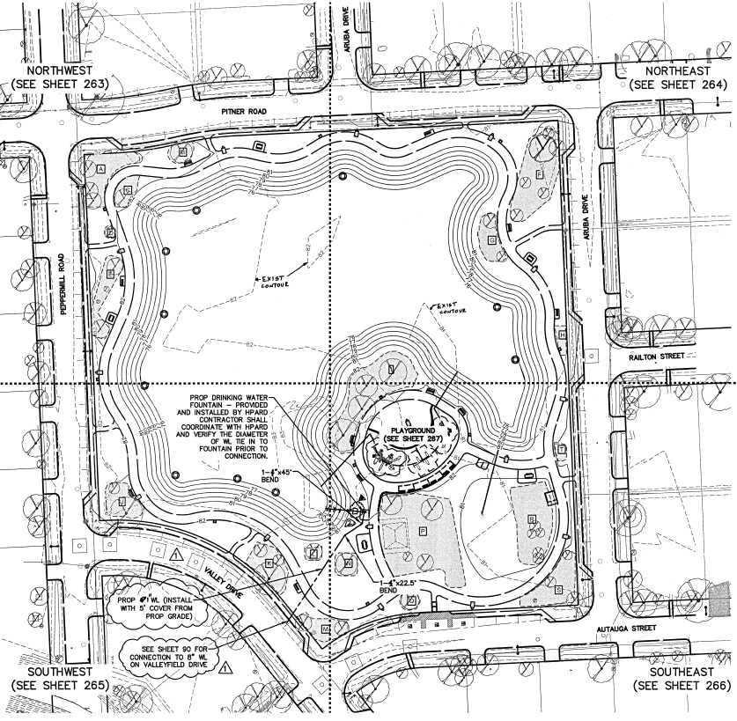
Binglewood Area Drainage and Paving
(WBS No. M-000293-0001-4)
Identified Improvement Needs
!
James W. Lee Park - Reconstruction
Playground, covered seating structure, bike rack, paved walking trail, security lighting, picnic tables and benches, trees and turf.

Slide 7
Binglewood Area Drainage and Paving
(WBS No. M-000293-0001-4)
Construction – Project Info
i
Keep your door hanger throughout the project
  Lists phone numbers you need
  Lists the Project Number
    Number needed when you call or write us
Meet the City PM or Inspector
  Will be your contact to resolve issues throughout construction
Construction will occur within the City right-of-way
  City right-of-way generally extends 8 to 16.5 feet into your yard (past proposed face of curb, lesser at some cul-de-sacs)

Slide 8


Binglewood Area Drainage and Paving
(WBS No. M-000293-0001-4)
Construction – How to Report a Problem
Contact 311
  Report the project number
  Request issue be directed to Public Works Capital Projects
  Be as complete as possible with your concern
Contact us at: pwecip@houstontx.gov

Slide 9
Binglewood Area Drainage and Paving
(WBS No. M-000293-0001-4)
What to Expect During Construction
!
Prepare for Construction
Document the conditions of your yard and sprinkler head locations; the contractor will do the same.
Remove special landscaping features (i.e., fountains, lawn art)
Find alternative parking
Plan for water service interruption
Be mindful of protective barriers
James W. Lee Park reconstruction (initial phase)
Potential Service Impacts:
Potential water service impacts
Potential parking/driveway access impacts
Trash/recycling receptacle location impacts
Limited number of tree removals/replacement per plan
Potential for school bus re-routes

Slide 10

Binglewood Area Drainage and Paving
(WBS No. M-000293-0001-4)
What to Expect During Construction
Water Services
Potential for service interruption:
  Waterline replacement - notification 24 to 48 hours in advance
  Periodic
  May last 2 to 4 hours
Accidental/Unplanned Interruption – the contractor will work quickly to restore services.

Slide 11
Binglewood Area Drainage and Paving
(WBS No. M-000293-0001-4)
What to Expect During Construction
P
Parking and Driveway Access
Short-periods of limited access to your driveway
Park elsewhere and walk to your home
Contact us immediately if need handicapped access
Short-periods of no on-street parking
Construction will alternate each side of the street, in steps
Suggest working with neighbors on the opposite side – they may need your help when it’s their turn

Slide 12

Binglewood Area Drainage and Paving
(WBS No. M-000293-0001-4)
What to Expect During Construction
Driveways
Driveway aprons will be reconstructed
If construction required beyond the apron, City will request a right-of-entry from property owner

Slide 13

Binglewood Area Drainage and Paving
(WBS No. M-000293-0001-4)
What to Expect During Construction
Trash/Recycling Pick-up
Potential for service interruption:
  Construction will alternate each side of the street, per steps of each phase
  Waste receptacles should be placed on the non-affected side of the street

Slide 14

Binglewood Area Drainage and Paving
(WBS No. M-000293-0001-4)
What to Expect During Construction
Trees
Our goal is to protect all trees during construction.
  We accomplish this by working with the City Arborist
  Unhealthy trees will be removed.
Some trees may be removed as part of the project
  New trees may be planted elsewhere in the project area, per plan.
Notes:
NEED TO ADD MORE SPECIFIC INFORMATION

Slide 15

Binglewood Area Drainage and Paving
(WBS No. M-000293-0001-4)
What to Expect During Construction
School Buses
The City of Houston and the Contractor work with all schools to minimize impacts to students, school bus schedules, and school bus stops
School buses may need to use different streets temporarily

Slide 16

Binglewood Area Drainage and Paving
(WBS No. M-000293-0001-4)
What to Expect During Construction
RESTORATION
Restoration of sprinkler systems, grass, etc. will be done when construction is complete.
City does not approve final payment to contractor until restoration is complete.
If you have concerns:
  Document (writing, photo, etc.)
  Call 3-1-1
  Do not make the repairs yourself

Slide 17
Binglewood Area Drainage and Paving
(WBS No. M-000293-0001-4)
Contact Information
  Triple B Services, Inc. (Contractor)
Fred Mitri, Project Manager Jackie Murphy, Field Project Manager | o: (281) 324-3264 ext.128 c: (832) 465-0273
  City of Houston – Contract Staff (oversight)
Ben Barajas, Sr. Construction Inspector (COH) | o: (832) 395-5842
TBD, Construction Manager TBD, Inspector (Entech Civil Engineers, Inc.; CM&I Contract Team) | o: (281) 945-0069
Kevin Hammond, Project Manager (COH) | o: (832) 395-2275 c: (832) 627-3450
Notes:
Hien to update

Slide 18
Binglewood Area Drainage and Paving
(WBS NO. M-000293-0001-4)
IMPORTANT LINKS
i
For a complete listing of Frequently Asked Questions please visit:
  https://www.publicworks.houstontx.gov/ecd/faqs.html
Today’s presentation and additional project information can be found at:
https://rebuildhouston.org/community-engagement

Slide 19
THANK YOU
Please find a breakout group at the Houston Public Works tables.

