Slide 1
WATER LINE REPLACEMENT IN MEMORIAL BEND AND BRIAR FOREST AREA
CONSTRUCTION COMMUNITY MEETING
WBS No. S-000035-0212-4
KEVIN HAMMOND, P.E.| SUPERVISING ENGINEER| SEPTEMBER 13, 2018

Slide 2
AGENDA
Overview of the Project
Project Phasing
What to Expect During Construction
Contact Information

Slide 3
OVERVIEW
Purpose: To replace and upgrade the existing water distribution system in the project area
Construction Cost: $2.1 Million
Timeline: 10-01-2018 Construction Begins
    07-29-2019 Anticipated Project Completion
2018
2019
Fall
Construction Begins
Summer
Anticipated Completion

Slide 4

OVERVIEW
Project Scope
Replace old water distribution system with new system to provide:
Improved Water Quality
Increased Water Capacity
Increased Water Circulation
Increased Fire Protection
Compliant with Current Standards

Slide 5
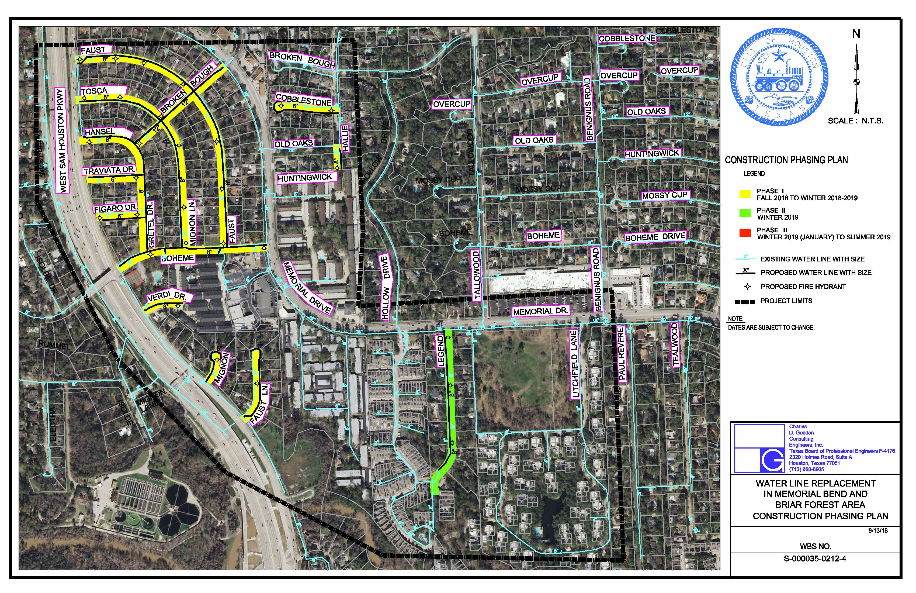
PROJECT PHASING
* SUBJECT TO CHANGES AS PROJECT UPDATES OCCUR.

Slide 6
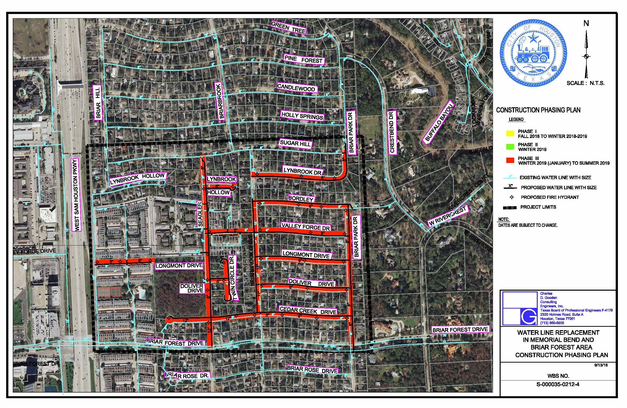
PROJECT PHASING
* SUBJECT TO CHANGES AS PROJECT UPDATES OCCUR.

Slide 7
WHAT TO EXPECT DURING CONSTRUCTION
Prepare for Construction
Construction is within the City’s Right-of-Way
Know how to report a concern or a problem
Be aware of the potential service impacts

Slide 8
WHAT TO EXPECT DURING CONSTRUCTION
City’s Right-of-Way (ROW)
City’s ROW generally extends 10-17 feet past curb line
Remove items of value (special landscaping features such as fountains and lawn art) within the City’s ROW
Document the conditions of your yard and sprinkler head locations, Contractor will do the same

Slide 9

WHAT TO EXPECT DURING CONSTRUCTION
How to Report a Concern or Problem
Keep your door hanger throughout the duration of the project
  It lists phone numbers you may need
  It lists the project’s name and the project’s number
Contact 311
  Report the project name and the project number
  Request issue be directed to Houston Public Works / Capital Projects
  Be as complete as possible with your concern
Meet with the City’s PM or Inspector
  Will be your contact to resolve issues throughout construction

Slide 10
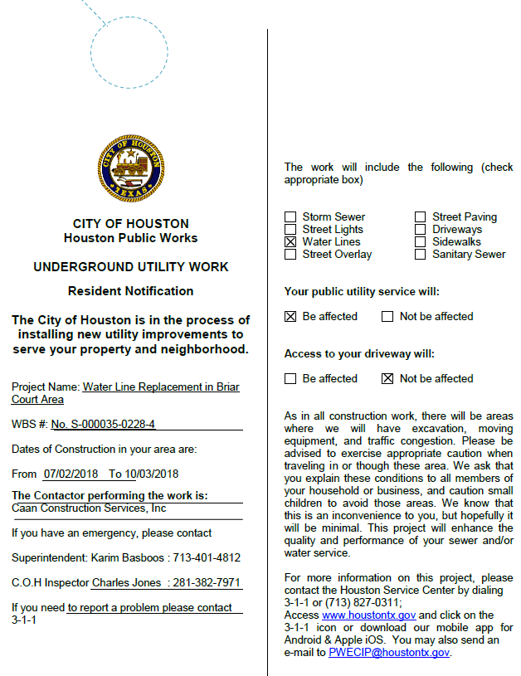
WLR in Memorial Bend and Briar Forest Area
(WBS No. S-000035-0212-4)
Construction – Project Info
i
WHAT TO EXPECT DURING CONSTRUCTION
Door Hanger
Project Name: Water Line Replacement in Memorial Bend and Briar Forest Area
WBS #: No. S-000035-0212-4
S-000035-0212-4
From: 10/1/2018 To: 07/29/2019
D.L. Elliott Enterprises, Inc.
John Bradford:832-472-2858

Slide 11
WHAT TO EXPECT DURING CONSTRUCTION
Potential Water Service Impacts
Planned service interruption:
  Waterline replacement - notification 24 to 48 hours in advance
  Periodic
  Typically last 2 to 4 hours
Accidental / Unplanned Interruptions:
  The contractor will work quickly to restore the services

Slide 12

WHAT TO EXPECT DURING CONSTRUCTION
Tree Removals/Replacement per plan
Our goal is to protect all trees during construction
  We accomplish this by working with the City Arborist
A few trees may be removed as part of the project
  New trees may be planted elsewhere in the project area, per plan.

Slide 13
WHAT TO EXPECT DURING CONSTRUCTION
Potential Bus Re-Routes
METRO Bus stops affected
Contractor will coordinate with METRO for any potential impacts

Slide 14
WHAT TO EXPECT DURING CONSTRUCTION
Restoration
Restoration of sprinkler systems, grass, etc. will be done at the end of each phase of construction
City does not approve final payment to the contractor until restoration is complete
If you have concerns:
  Document (writing, photo, etc.)
  Call 3-1-1
  Do not make the repairs yourself

Slide 15
CONTACT INFORMATION
  D.L. Elliott Enterprises, Inc. (constructing proposed work)
Dwayne Schroeder– Project Manger | (281) 838-4220
John Bradford- Superintendent | (832) 472-2858
  City of Houston Staff (oversight)
Sabeen Shaikh- Project Manager | (832) 395-2307
Nancy Serag-Eldin- Inspector | (832) 808-6514
Charles Jones-Inspector | (281) 382-7971
HOUSTON PUBLIC WORKS | 611 WALKER STREET | HOUSTON, TX 77002 | PWECIP@HOUSTONTX.GOV
Notes:
Hien to update

Slide 16
IMPORTANT LINKS
For a complete listing of Frequently Asked Questions please visit:
https://www.publicworks.houstontx.gov/ecd/faqs.html
Today’s presentation and additional project information can be found at:
https://rebuildhouston.org/community-engagement

Slide 17
THANK YOU
Next Up
Question & Answer
Breakout session

